Slide 1








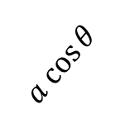

DOT/SCALAR PRODUCT
Scalar: $± number$
Definition
The dot/scalar product of two vectors $\vec{a}$and $\vec{b}$ is:
$$\vec{b}$$
$$\vec{a} • \vec{b}= \vec{b} • \vec{a} =\left|\vec{a}\right|\left|\vec{b}\right|\cos{θ}$$
θ
$$\vec{a}$$
or: Product of the length of one of them and
projection of the other one on the first one
$$\vec{b}$$
$$a cos{θ}$$
$$\vec{b}$$
$$\vec{a}$$
$$b cos{θ}$$
$$\vec{a}$$

Slide 2
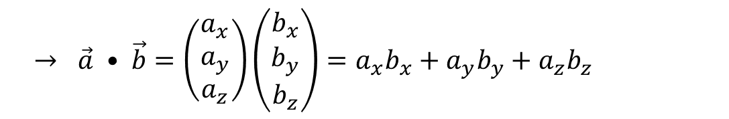
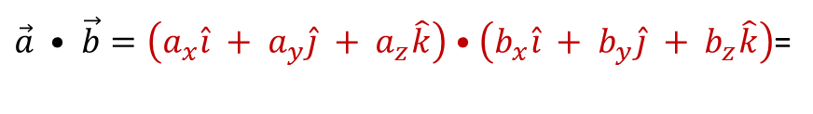
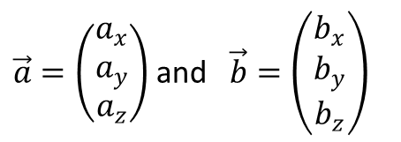
In Cartesian coordinates:
$\vec{a}=\left(\begin{matrix}a_{x} \\ a_{y} \\ a_{z}\end{matrix}\right)$ and $\vec{b}=\left(\begin{matrix}b_{x} \\ b_{y} \\ b_{z}\end{matrix}\right)$
$$\hat{i} •\hat{i} =1 \hat{j}•\hat{j}=1 \hat{k}•\hat{k}=1 \& \hat{i}•\hat{j}=0 \hat{i}•\hat{k}=0 \hat{j}•\hat{k}=0 \left(\cos{{90}^{0}=0}\right)$$
$\vec{a} • \vec{b}=\left(a_{x}\hat{i} + a_{y}\hat{j} + a_{z}\hat{k}\right)$ $•\left(b_{x}\hat{i} + b_{y}\hat{j} + b_{z}\hat{k}\right)$=
$$→ \vec{a} • \vec{b}=\left(\begin{matrix}a_{x} \\ a_{y} \\ a_{z}\end{matrix}\right)\left(\begin{matrix}b_{x} \\ b_{y} \\ b_{z}\end{matrix}\right)=a_{x}b_{x}+a_{y}b_{y}+a_{z}b_{z}$$

Slide 3



Properties of dot product
$$∎ \vec{a} • \vec{b}= \vec{b} • \vec{a}$$
$$∎ if \vec{a} and \vec{b} are parallel, then \vec{a} • \vec{b}= \left|\vec{a}\right|\left|\vec{b}\right|$$
$$∎ if \vec{a} and \vec{b} are antiparallel, then \vec{a} • \vec{b}=− \left|\vec{a}\right|\left|\vec{b}\right|$$
$$∎ \vec{a} • \vec{a}= {\left|\vec{a} \right|}^{2}$$
$$∎ \vec{a} •\left(\vec{b} + \vec{c}\right)=\vec{a}•\vec{b} + \vec{a}•\vec{c}$$
$$∎ \left(\vec{a}+\vec{b}\right) •\left(\vec{c}+\vec{d}\right)=\vec{a}•\vec{c} + \vec{a}•\vec{d}+\vec{b}•\vec{c} + \vec{b}•\vec{d}$$
$∎ \vec{a} • \vec{b}=0 \left(\vec{a} ≠0, \vec{b}≠0\right) ↔ \vec{a} and \vec{b} are perpendicular$

Slide 4
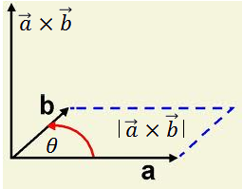




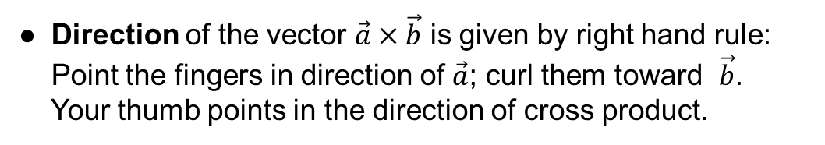
CROSS / VECTOR PRODUCT
Definition
● The magnitude of the vector $\vec{a}×\vec{b}$is equal
to the area determined by both vectors.
$$\left|\vec{a} ×\vec{b}\right|= \left|\vec{a}\right|\left|\vec{b}\right| sin θ$$
● Direction of the vector $\vec{a}×\vec{b}$ is given by right hand rule:
Point the fingers in direction of $\vec{a}$; curl them toward $\vec{b}$.
Your thumb points in the direction of cross product.
$$\vec{b}×\vec{a}=−\vec{a} ×\vec{b}$$

Slide 5

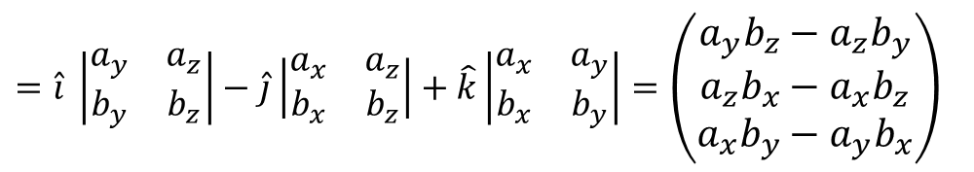
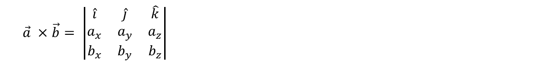




In Cartesian coordinates:
$$\hat{i}$$
$$\hat{j}$$
$$\hat{k}$$
Using properties of determinates
$$\left|\begin{matrix}a & b \\ c & d\end{matrix}\right|=ad−cb$$
We can write cross product in simple form:
$$+ − +$$
$$\vec{a} ×\vec{b}= \left|\begin{matrix}\hat{i} & \hat{j} & \hat{k} \\ a_{x} & a_{y} & a_{z} \\ b_{x} & b_{y} & b_{z}\end{matrix}\right|$$
$$=\hat{i} \left|\begin{matrix}a_{y} & a_{z} \\ b_{y} & b_{z}\end{matrix}\right|−\hat{j}\left|\begin{matrix}a_{x} & a_{z} \\ b_{x} & b_{z}\end{matrix}\right|+\hat{k}\left|\begin{matrix}a_{x} & a_{y} \\ b_{x} & b_{y}\end{matrix}\right|=\left(\begin{matrix}a_{y}b_{z}−a_{z}b_{y} \\ a_{z}b_{x}−a_{x}b_{z} \\ a_{x}b_{y}−a_{y}b_{x}\end{matrix}\right)$$

Slide 6


Properties of vector/cross product
$$∎ \vec{a} × \vec{b}=− \vec{b} × \vec{a}$$
$$∎ if \vec{a} and \vec{b} are perpendicular, then \left|\vec{a} × \vec{b}\right|= \left|\vec{a}\right|\left|\vec{b}\right|$$
$$∎ \vec{a} ×\left(\vec{b} + \vec{c}\right)=\vec{a}×\vec{b} + \vec{a}×\vec{c}$$
$$∎ \left(\vec{a}+\vec{b}\right) ×\left(\vec{c}+\vec{d}\right)=\vec{a}×\vec{c} + \vec{a}×\vec{d}+\vec{b}×\vec{c} + \vec{b}×\vec{d}$$
$$∎ \vec{a} × \vec{b}= 0 \left(\vec{a} ≠0, \vec{b}≠0\right) ↔ \vec{a} and \vec{b} are parallel$$
$For parallel vectors the vector product is 0.$

Slide 7


$$\vec{a} = 5\hat{i}−2\hat{j} +\hat{k}$$
$$\vec{b} = \hat{i}+\hat{j}−3\hat{k}$$
(a) Find the angle between them
(b) Find the unit vector perpendicular to both
(a) $θ=arc sin$ $\frac{\left|\vec{a} × \vec{b}\right|}{\left|\vec{a}\right|\left|\vec{b}\right|}$
$$\vec{a} ×\vec{b}=\left|\begin{matrix}\hat{i} & \hat{j} & \hat{k} \\ 5 & −2 & 1 \\ 1 & 1 & −3\end{matrix}\right|= 5\hat{i}+16\hat{j}+7\hat{k}$$
$$\left|\vec{a} × \vec{b}\right|=\left|5\hat{i}+16\hat{j}+7\hat{k}\right|=\sqrt{330}$$
$\left|\vec{a} \right|=\sqrt{30} \left|\vec{b} \right|=\sqrt{11}$
$$θ=arc sin 1 = π/2$$
(b) $\hat{n}=$ $\frac{\vec{a} ×\vec{b}}{\left|\vec{a} ×\vec{b}\right|}$ = $\frac{1}{\sqrt{330}}$ $\left(\begin{matrix}5 \\ 16 \\ 7\end{matrix}\right)$
Find all vectors perpendicular to both
$$\vec{a}=\left(\begin{matrix}1 \\ 2 \\ 3\end{matrix}\right) and \vec{b}=\left(\begin{matrix}3 \\ 2 \\ 1\end{matrix}\right)$$
$$\vec{a}×\vec{b}=\left|\begin{matrix}\hat{i} & \hat{j} & \hat{k} \\ 1 & 2 & 3 \\ 3 & 2 & 1\end{matrix}\right|=\left(\begin{matrix}−4 \\ 8 \\ −4\end{matrix}\right)$$
$$⤇ vector of the form k\left(\hat{i}−2\hat{j}+\hat{k}\right)$$
$where k is any non−zero real number.$

Slide 8

Find the area of the triangle with vertices A(1,1,3), B(4,-1,1), and C(0,1,8)
It is one-half the area of the parallelogram determined by the vectors
$\vec{AB}=\left(\begin{matrix}3 \\ −2 \\ −2\end{matrix}\right)$ and $\vec{AC}=\left(\begin{matrix}−1 \\ 0 \\ 5\end{matrix}\right)$
$$\frac{1}{2}\left|\vec{AB}×\vec{BC}\right|=\frac{1}{2}\left|\left|\begin{matrix}\hat{i} & \hat{j} & \hat{k} \\ 3 & −2 & −2 \\ −1 & 0 & 5\end{matrix}\right|\right| ⤇\frac{1}{2} \left|\left(\begin{matrix}−10 \\ −13 \\ −2\end{matrix}\right)\right|=\frac{1}{2} \sqrt{{(−10)}^{2}+{(−13)}^{2}+{(−2)}^{2}}$$
$=8.26 {units}^{2}$

Slide 9

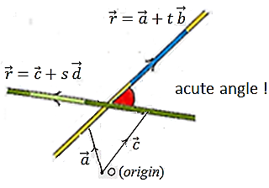
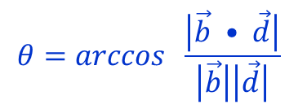


How do we use dot and cross product
• To find angle between vectors the easiest way is to use dot product, not vector product.
$$θ=arccos \frac{\vec{b} • \vec{d}}{\left|\vec{b}\right|\left|\vec{d}\right|}$$
• Angle between vectors can
be acute or obtuse
$$θ=arccos \frac{\left|\vec{b} • \vec{d}\right|}{\left|\vec{b}\right|\left|\vec{d}\right|}$$
• Angle between lines is by definition
acute angle between them, so
$\vec{b} and \vec{d}$ are direction vectors
Dot product of perpendicular vectors is zero.
• To show that two lines are perpendicular use the dot product with line direction vectors.
• To show that two planes are perpendicular use the dot product on their normal vectors.

Slide 10
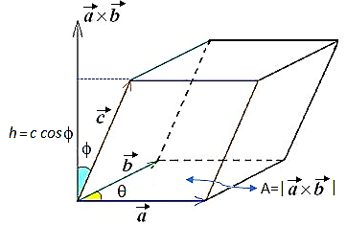
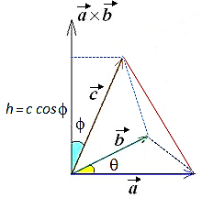
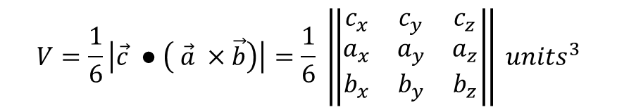
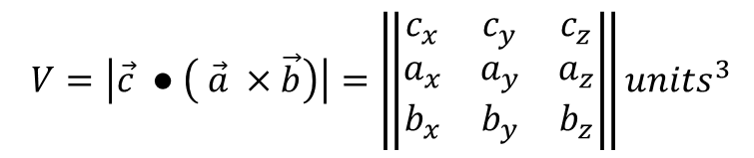
Volume of a parallelepiped = scalar triple product
$$V=\left|\vec{c} ● \left( \vec{a} ×\vec{b}\right)\right|=\left\|\begin{matrix}c_{x} & c_{y} & c_{z} \\ a_{x} & a_{y} & a_{z} \\ b_{x} & b_{y} & b_{z}\end{matrix}\right\|{units}^{3}$$
Volume of a tetrahedron = $\frac{1}{6}$ scalar triple product
$$V=\frac{1}{6}\left|\vec{c} ● \left( \vec{a} ×\vec{b}\right)\right|=\frac{1}{6} \left\|\begin{matrix}c_{x} & c_{y} & c_{z} \\ a_{x} & a_{y} & a_{z} \\ b_{x} & b_{y} & b_{z}\end{matrix}\right\| {units}^{3}$$
TEST FOR FOUR COPLANAR POINTS
$$▪ Four points are coplanar if and only if the volume of the tetrahedron$$
$defined by them is 0:$

Slide 11
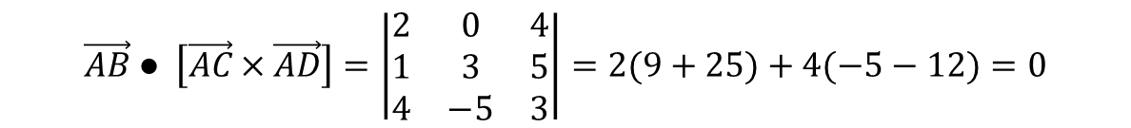


Are the points A(1, 2, -4), B(3, 2, 0), C(2, 5, 1) and D(5, -3, -1) coplanar?
$$\vec{AB}=\left(\begin{matrix}2 \\ 0 \\ 4\end{matrix}\right) \vec{AC}=\left(\begin{matrix}1 \\ 3 \\ 5\end{matrix}\right) \vec{AD}=\left(\begin{matrix}4 \\ −5 \\ 3\end{matrix}\right) ⤇$$
$$\vec{AB} ● \left[\vec{AC}×\vec{AD}\right]=\left|\begin{matrix}2 & 0 & 4 \\ 1 & 3 & 5 \\ 4 & −5 & 3\end{matrix}\right|=2(9+25)+4(−5−12)=0$$
$$∴ A, B, C and D are coplanar Q.E.D$$

